Slide 1

Is this image that image?
Asserting integrity beyond the fixity
Poster #3
Session #10
iPRES2021
JAY.GATTUSO@DIA.GOVT.NZ
All examples and required code is in this repo:
https://github.com/NLNZDigitalPreservation/diff_depth_analysis

Slide 2
Background
Fixity works really well as a binary “sameness” test
When we know or expect change as an outcome of a treatment, is there a way of indicating what that change is, and the case of images, where that change is?
Introducing difference depth analysis
identifying and indicating visual differences between two images

Slide 3
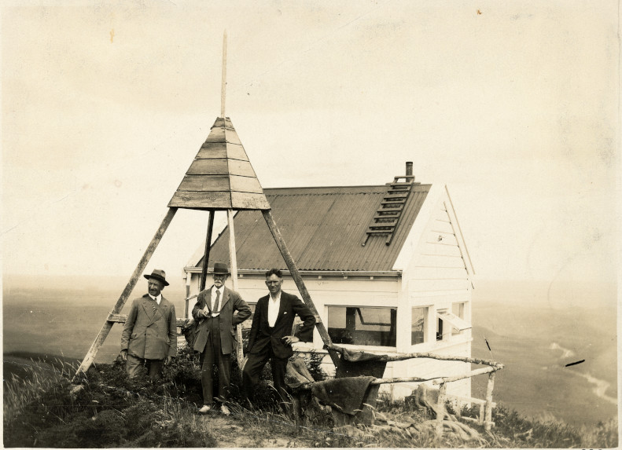
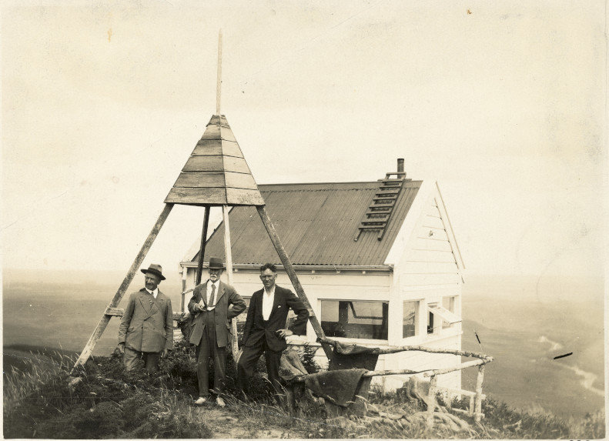

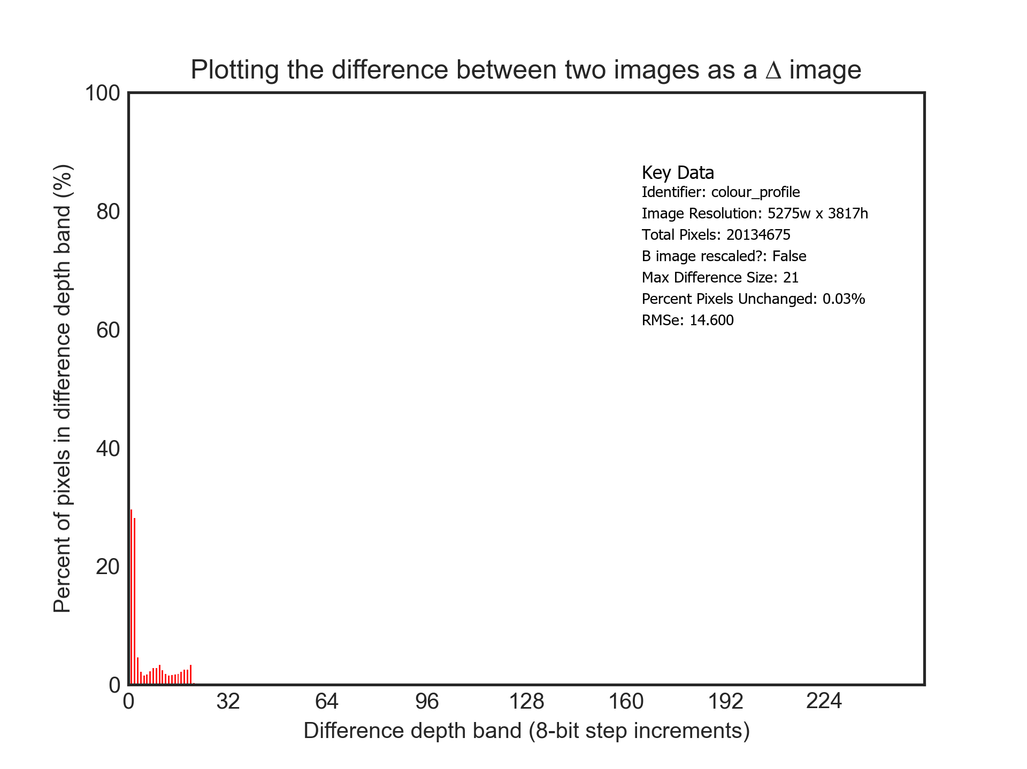
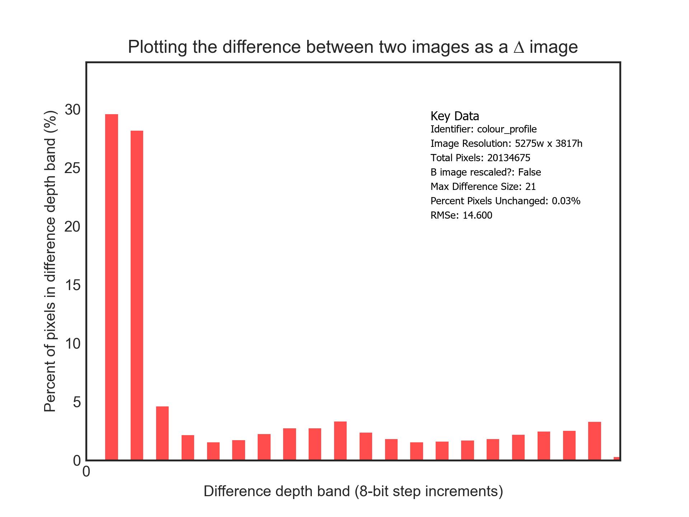
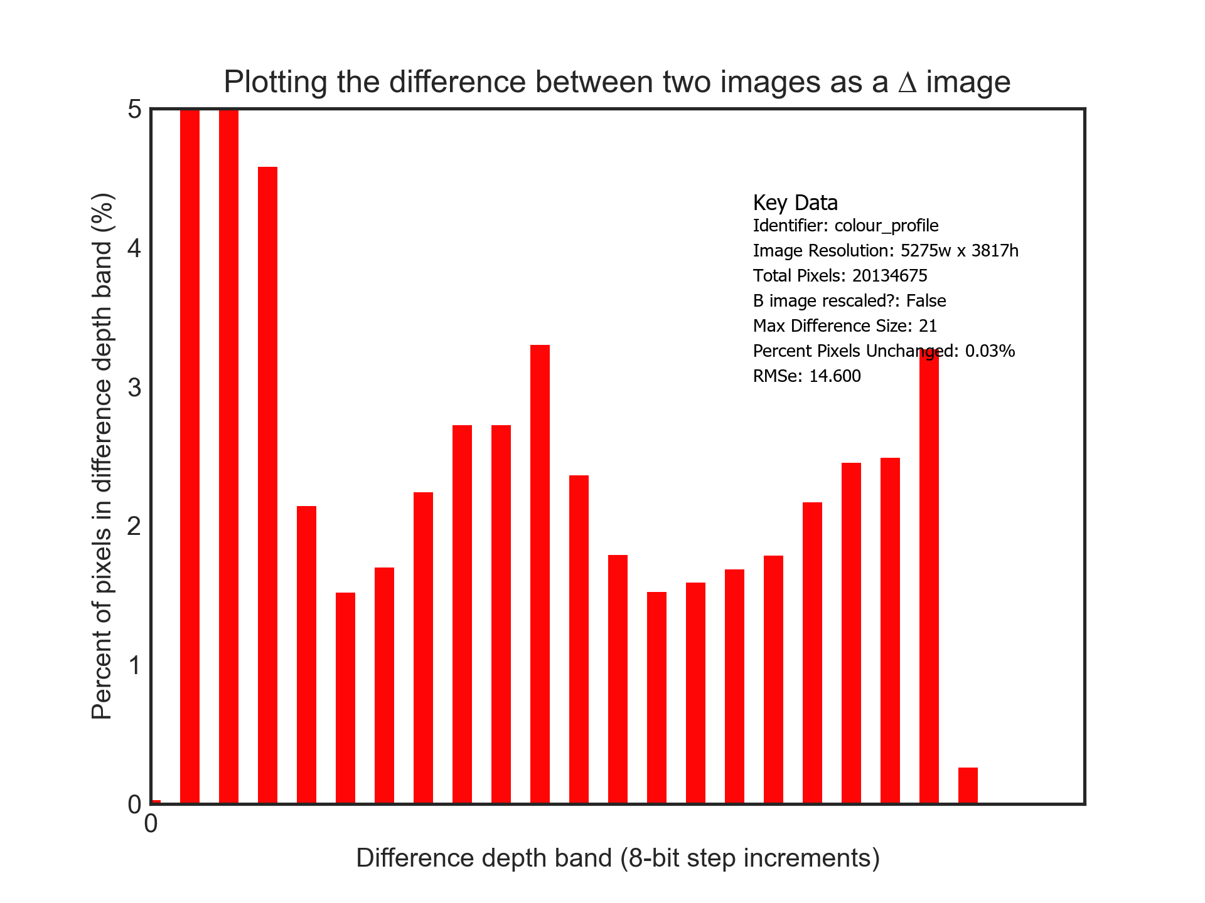
UC1: Difference testing
A
B
Diff
UC1: A new process is being tested to address a validation risk found in some image files.
Test of potential treatments revealed in issue with how colour profiles are being managed

Slide 4
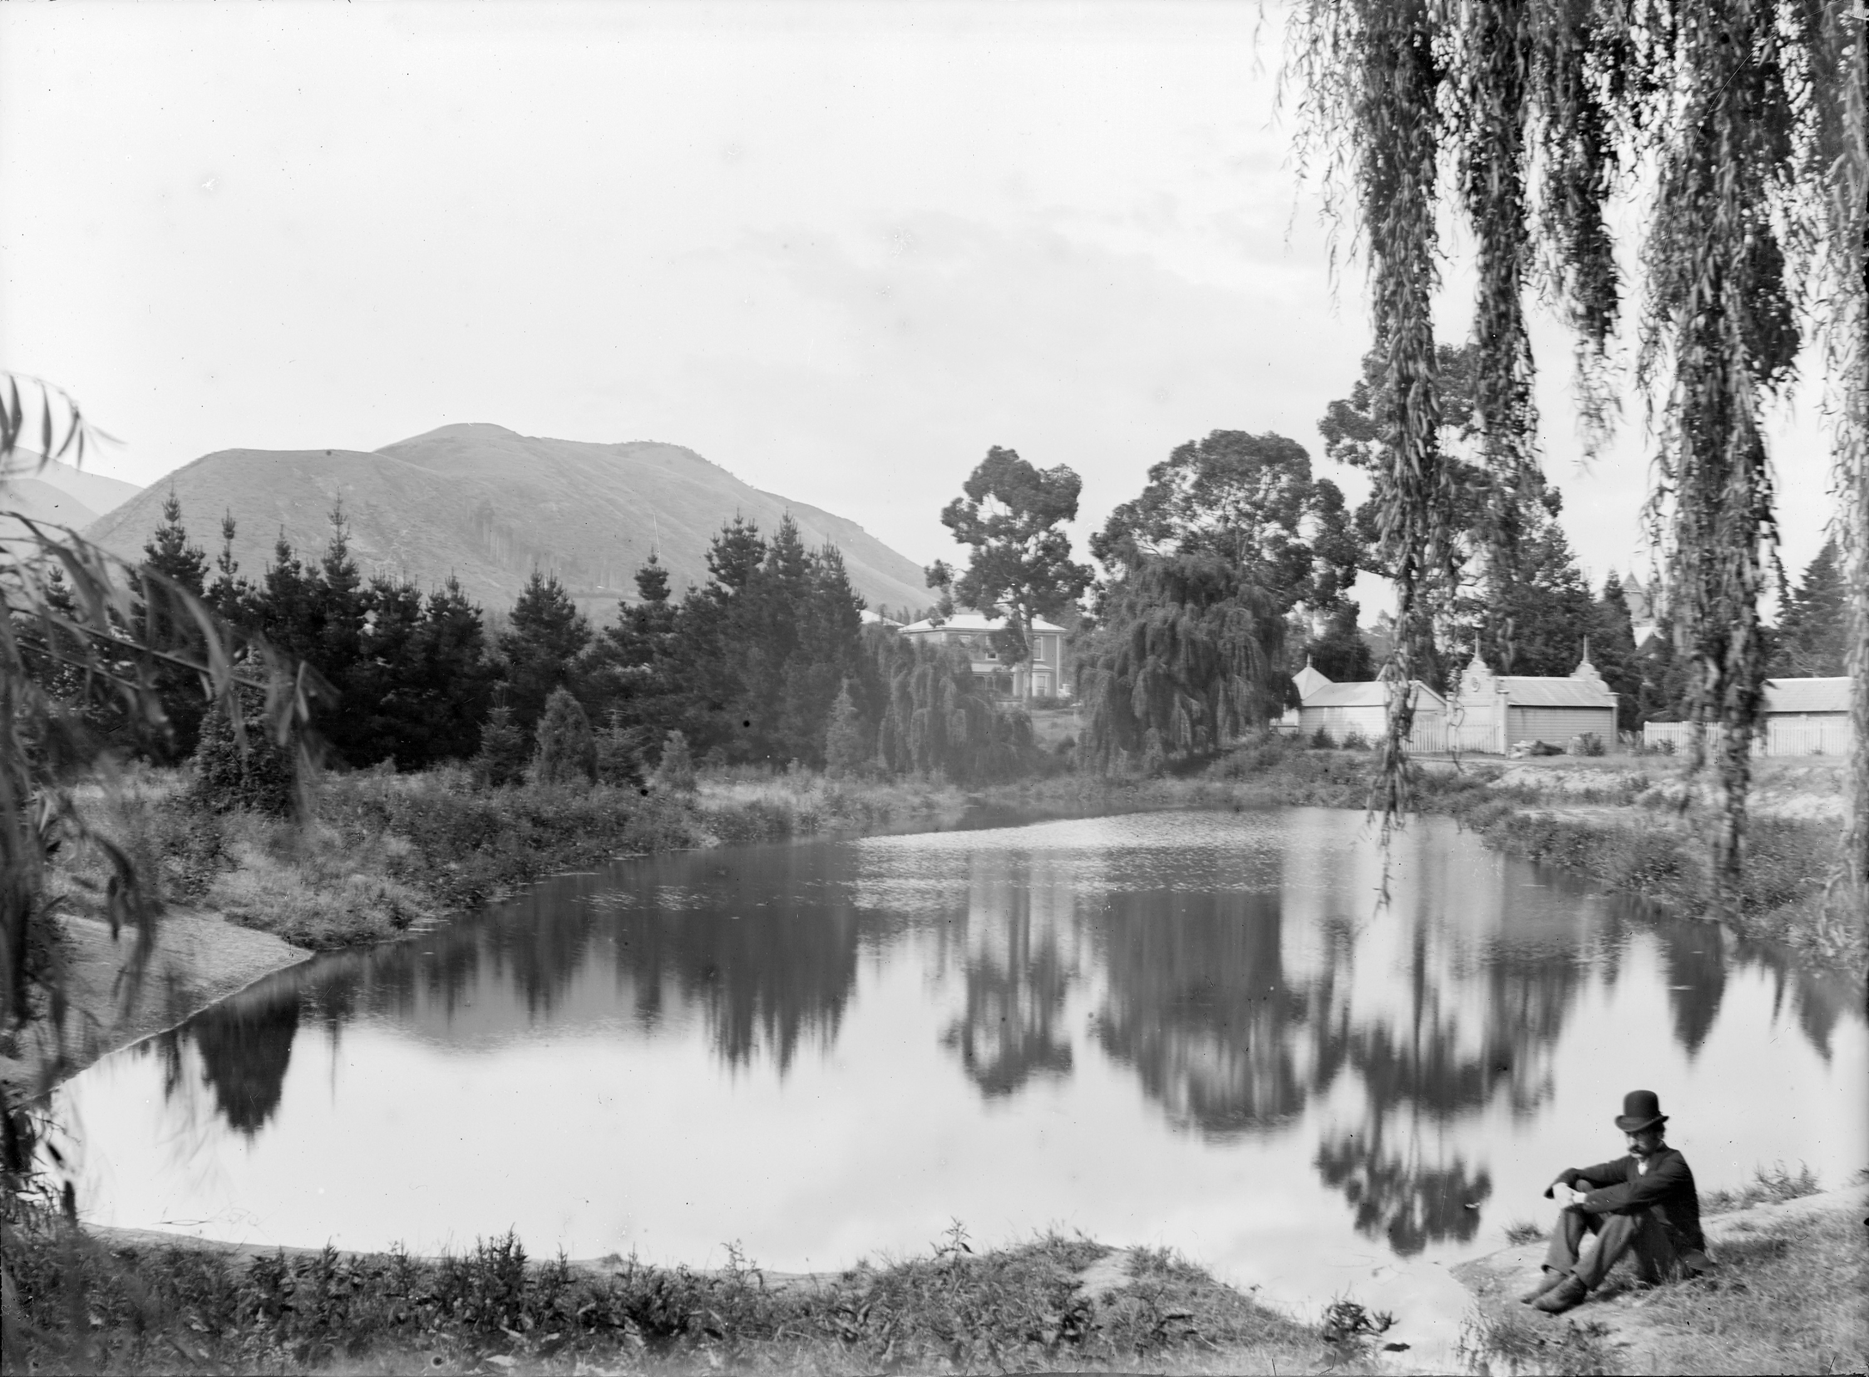
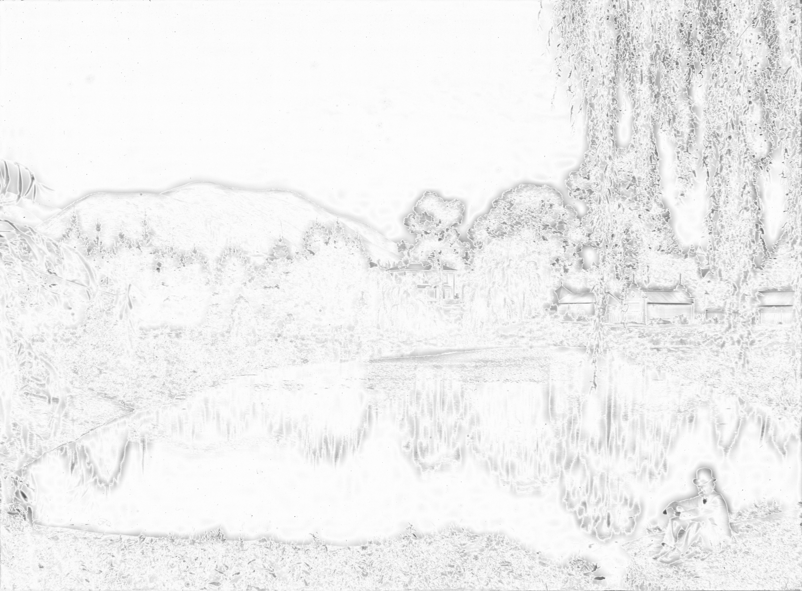


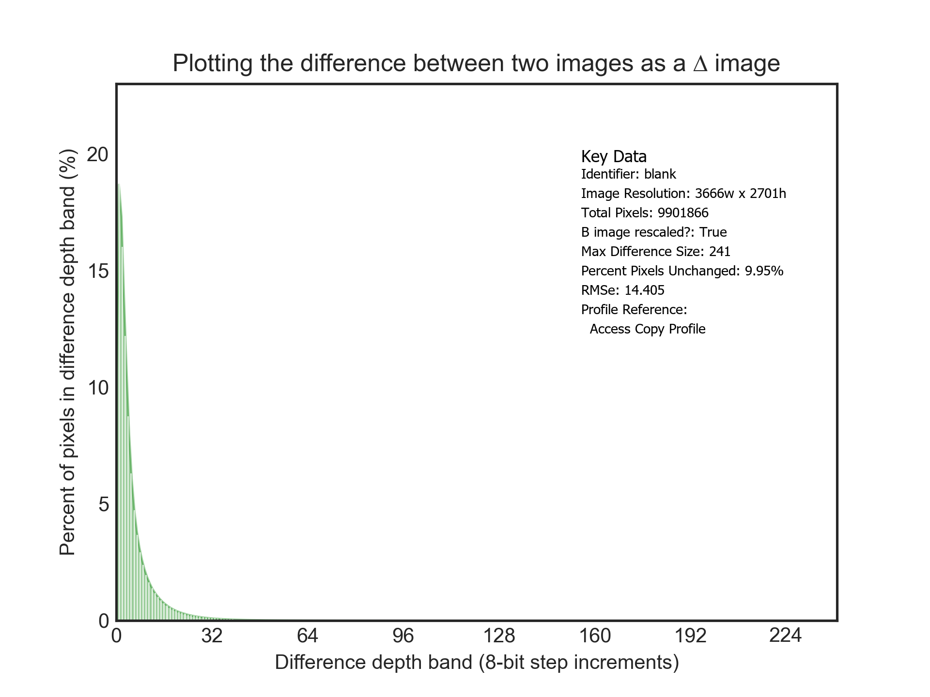
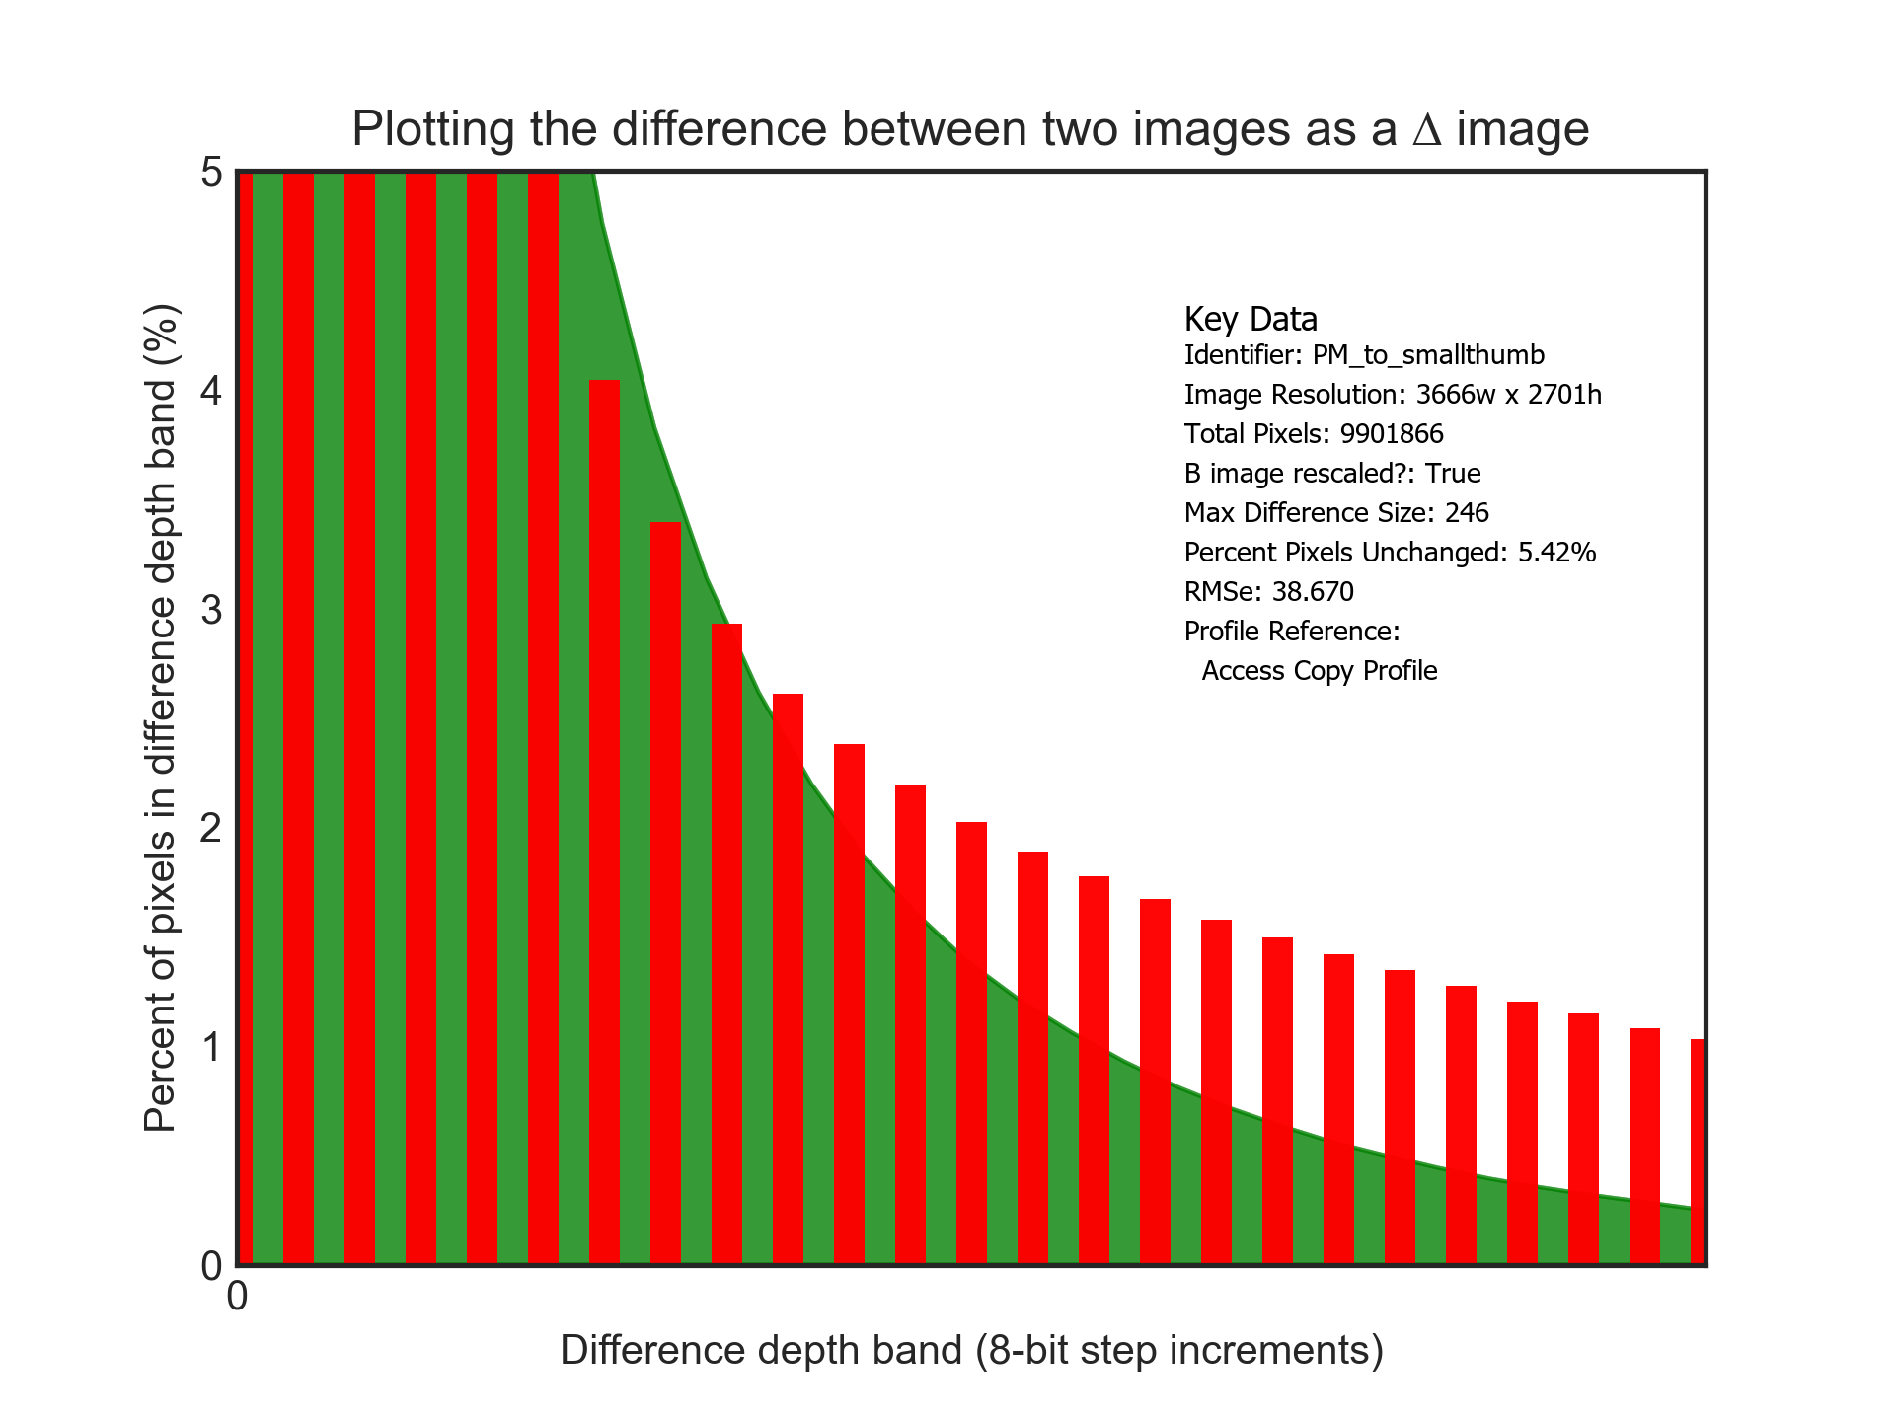
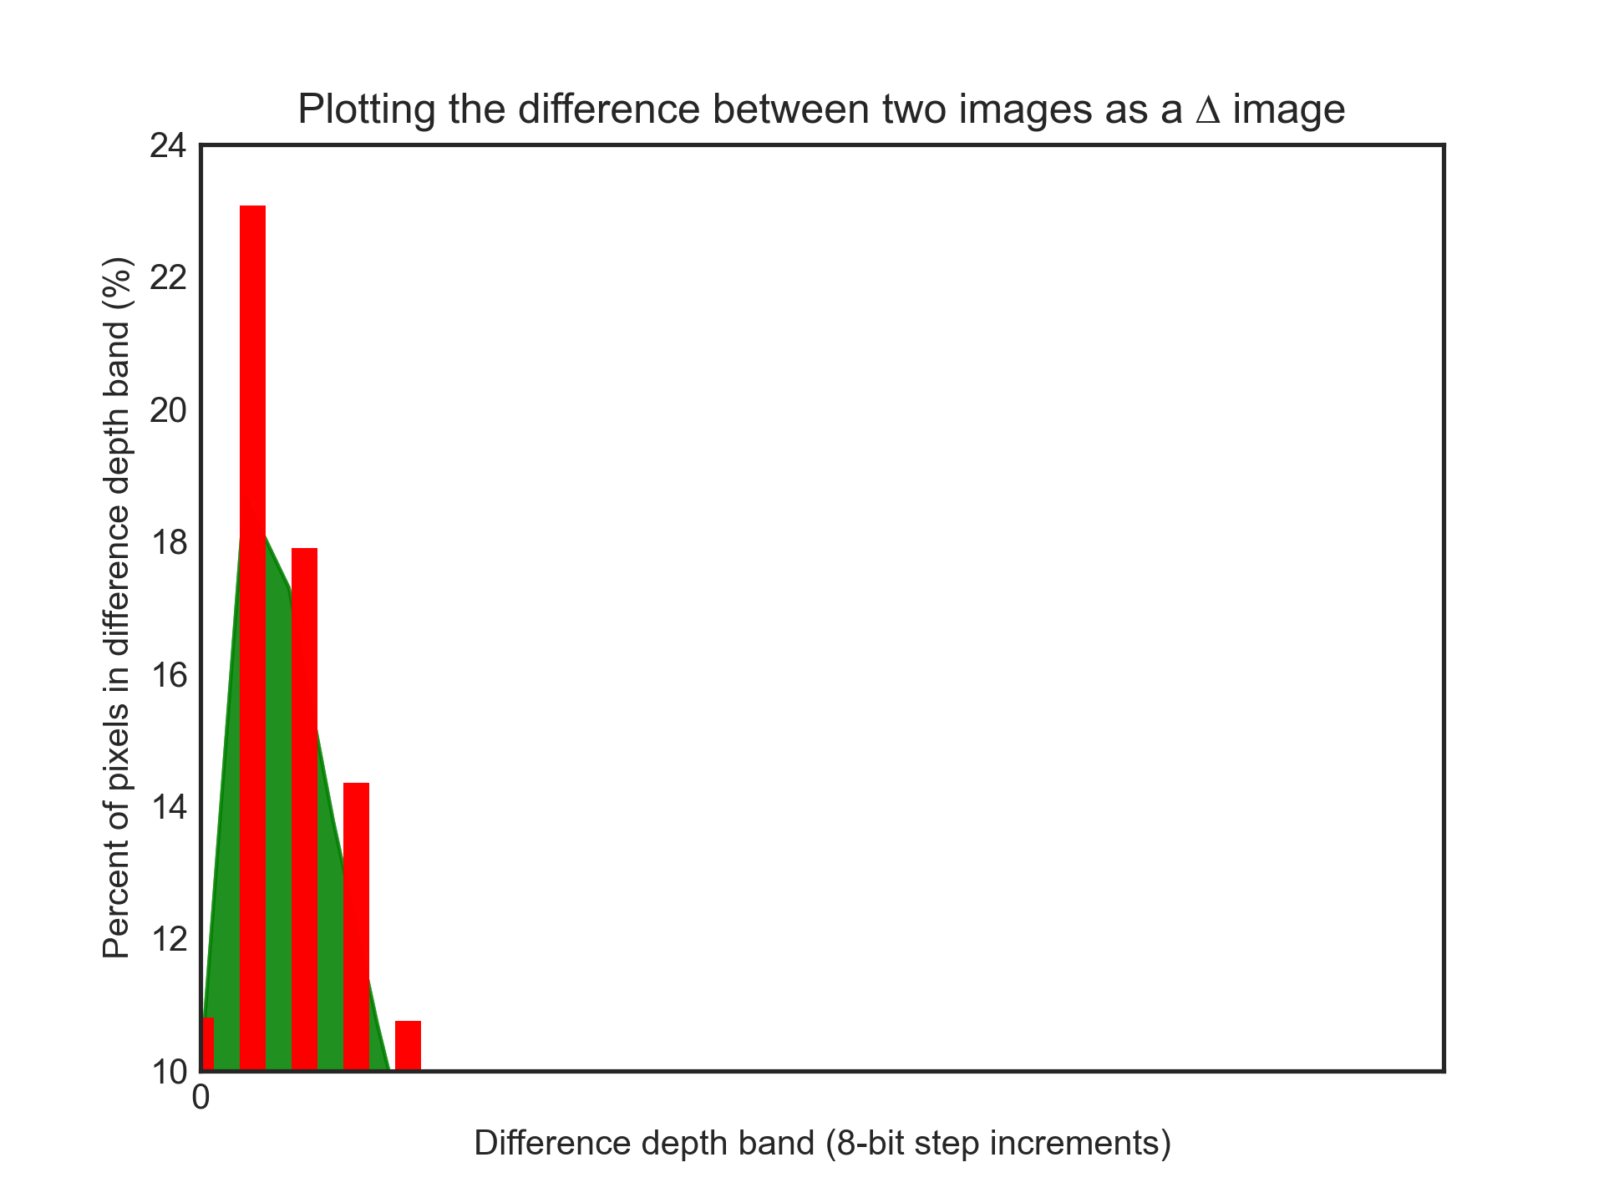
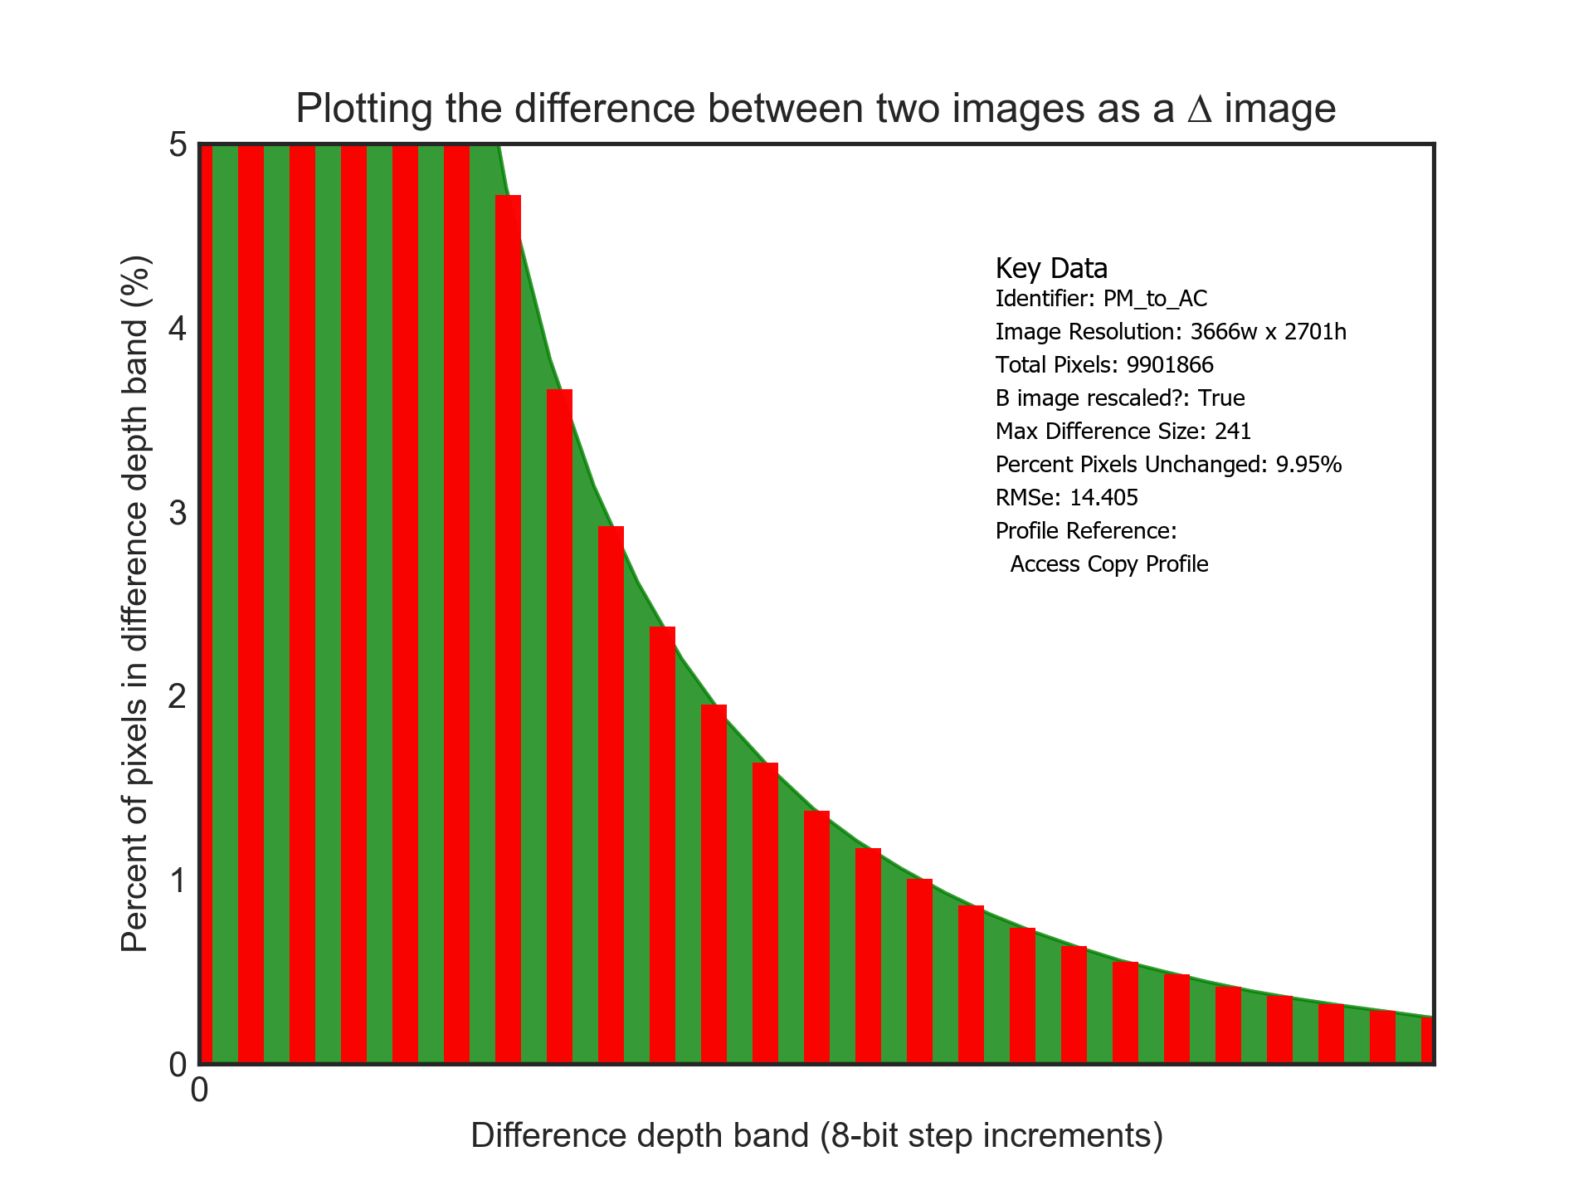
UC2: Fidelity Profile for Access Copies
Original Image High resolution digitised photograph
Aggressively compressed image
(Difference image)
Resized and compressed
(Difference image)
Resized (too small) image
(Difference image)
UC2: Creating access copies of master files that must meet a fidelity criteria.

Slide 5

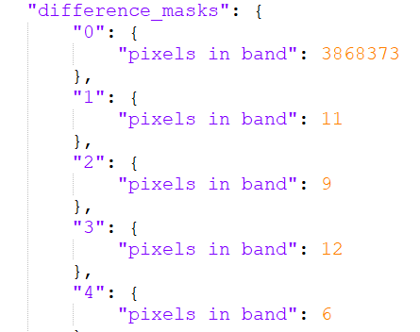

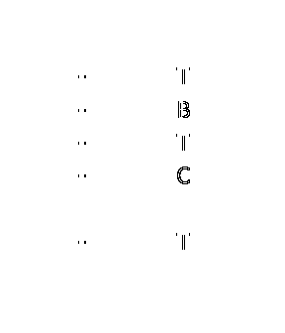
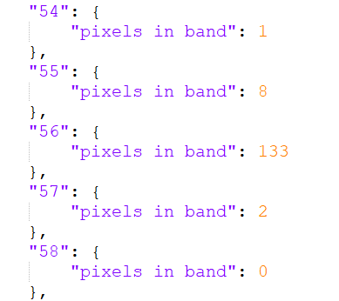
UC3: Post processing validation for PDF
Based on the detail section above, we can see that this is due to a minor (+/- ~3 pixels) x/y shift in one of parts of one of the elements of that page.
…
UC3: Processing to fix a validation issue with a PDF file results in files with different fixity values. Human inspection can not locate any changes
In this page we see ~200 pixels in one location, centred mostly around a particular change band that experienced some text/font rendering difference.

